Slide 1

CIRCULAR QUEUES

Slide 2
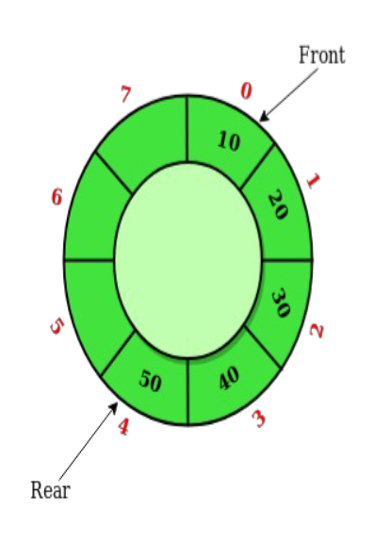
CIRCULAR QUEUES
Circular Queue is a variation of the traditional linear queue, where the last element connects back to the first element, forming a circular structure.
This ensures continuous use of memory and efficient space utilization.
The front and rear pointers wrap around the array, allowing us to enqueue elements at the rear and dequeue elements from the front while keeping the logical order intact.

Slide 3
Need for Circular Queue
In a standard linear queue implemented using arrays, there is a limitation in reusing the vacant spaces left after dequeueing elements.
As elements are dequeued from the front, the queue's front pointer moves forward, leaving unused memory space at the beginning. This inefficient memory usage can be overcome with the Circular Queue.

Slide 4
Circular Queue Operations
• Enqueue: Adding an element to the rear of the queue.
• Dequeue: Removing an element from the front of the queue.
• Front: Accessing the front element of the queue without removing it.
• Rear: Accessing the rear element of the queue without removing it.
• IsEmpty: Checking if the queue is empty.
• IsFull: Checking if the queue is full.

Slide 5
Circular Queue Implementation
CircularQueue:
max_size // maximum size of the Circular Queue
queue // an array to hold the elements of the Circular Queue
front // pointer to the front of the Circular Queue
rear // pointer to the rear of the Circular Queue
Constructor to initialize the Circular Queue
CircularQueue(max_size):
max_size = max_size
queue = [None] * max_size
front = rear = -1

Slide 6
Function to check if the Circular Queue is empty
is_empty():
return front == -1
Function to check if the Circular Queue is full
is_full():
return (rear + 1) % max_size == front

Slide 7
Enqueue
enqueue(data):
if is_full():
// The Circular Queue is full, enqueue operation cannot be performed
return "Queue is full"
if is_empty():
// If the Circular Queue is empty, set both front and rear to 0
front = rear = 0
else:
// Increment the rear pointer in a circular manner
rear = (rear + 1) % max_size
// Add the new element to the rear of the Circular Queue
queue[rear] = data
return "Enqueued element"

Slide 8
Dequeue
dequeue():
if is_empty():
// The Circular Queue is empty, dequeue operation cannot be performed
return "Queue is empty"
// Get the element to dequeue
data_to_dequeue = queue[front]
if front == rear:
// If there is only one element, reset front and rear to -1 to indicate an empty queue
front = rear = -1
else:
// Increment the front pointer in a circular manner
front = (front + 1) % max_size
return data_to_dequeue

Slide 9
Front element of the Circular Queue
peek_front():
if is_empty():
// The Circular Queue is empty, no front element to peek
return "Queue is empty"
return queue[front]

Slide 10
Rear element of the Circular Queue
peek_rear():
if is_empty():
// The Circular Queue is empty, no rear element to peek
return "Queue is empty"
return queue[rear]

Slide 11
Advantages of Circular Queue
1. Efficient Memory Utilization: Circular Queues overcome the issue of wasted space by reusing the vacant slots.
2. Simplicity in Implementation: They can be implemented using arrays, which are contiguous blocks of memory.
3. Continuous Data Flow: Circular Queues allow continuous data flow without the need for resetting the front pointer.

Slide 12
Applications of Circular Queues
• Printer Spooling: Managing print jobs in a printer queue.
• CPU Task Scheduling: Scheduling tasks in operating systems.
• Buffer Management in Networking: Handling data packets in network routers.

Slide 13
Review Questions
1. Explain the concept of a circular queue? How is it better than a linear queue?
2. Draw the queue structure in each case when the following operations are performed on an empty queue.
(a)Add A, B, C, D, E, F. (b) Delete two letters
(c) Add G (d) Add H
(e) Delete four letters (f) Add I
3. The circular queue will be full only when _____.
(a) FRONT=MAX-1 and REAR=MAX-1 (b) FRONT=0 and REAR=MAX-1
(c) FRONT=MAX-1 and REAR=0. (d) FRONT=0 and REAR=0
4. The function that deletes values from a queue is called ______.
(a) Enqueue (b)dequeue
(c) Pop (d) peek
5. New nodes are added at of the queue.
6. _________ allows insertion of elements at either ends but not in the middle.
7. A queue is a _____ data structure in which the element that is inserted first is the first one to be taken out.
8. In a circular queue, the first index comes after the ______ index.
9. In the computer’s memory, queues can be implemented using _________ and _______.
10. The storage requirement of linked representation of queue with n elements is ____ and the typical time
requirement for operations is _______.

